Slide 1
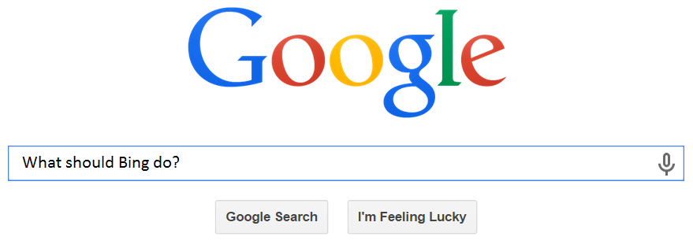
Search Engine Industry
Sophie Wyman, Dara DeMatteo,
Falak Shah, Shenil Shah
Notes:
http://www.bingiton.com/?form=MN03OW&crea=879

Slide 2
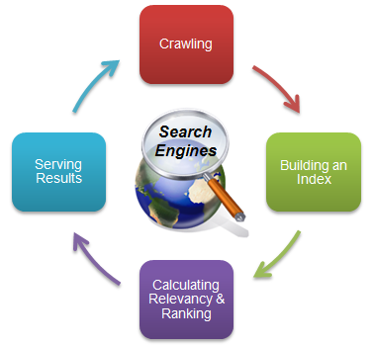
Just Google it…
Internet Publishing and Broadcasting
Internet Service Providers
Search Engines
Retail Trade Advertising Agencies Consumers
$5,018B Market Cap
Yahoo! was pioneer in the industry
Notes:
Hoopes, Stephen. Search Engines in the US. Rep. no. 51913a. IBISWorld, Aug. 2014. Web. <http://clients1.ibisworld.com.ezproxy.bu.edu/reports/us/industry/default.aspx?entid=1982>.
"Internet Information Providers Overview: Industry Center - Yahoo Finance." Internet Information Providers Overview: Industry Center - Yahoo Finance. Yahoo!, n.d. Web. 24 Nov. 2014. <https://biz.yahoo.com/ic/851.html>.
"The Industry Handbook: The Internet Industry | Investopedia." Investopedia. N.p., n.d. Web. 24 Nov. 2014. <http://www.investopedia.com/features/industryhandbook/internet.asp>.
Search Engine Industry:
Companies that operate search engines and other search-based websites that display advertisements to generate revenue as well as offer e-mail, news and social networking services.
1. Search engines navigate the web by crawling (or following each link from page to page)
2. They then sort the pages by their content and other factors and store them in an index (not the documents themselves but words that relate to the document)
3. They build programs and algorithms that help narrow down the search and translate exactly what the person is looking for (to make it relevant). This stage is also where there are differing systems, like a ranking system that uses factors (location, quality, safety).
4. Show the results

Slide 3
SE Exposed
Notes:
Admin, Techie. "Learn How Google Search Works? From Algorithms to Answers in Animations." Welcome to Support IT Desk RSS. N.p., n.d. Web. 24 Nov. 2014. <http://www.supportitdesk.com/learn-how-google-search-works-from-algorithms-to-answers-in-animations/>.
"SEO: The Free Beginner's Guide from Moz." Moz. N.p., n.d. Web. 23 Nov. 2014. <http://moz.com/beginners-guide-to-seo/how-search-engines-operate>.
1. Search engines navigate the web by crawling (or following each link from page to page)
2. They then sort the pages by their content and other factors and store them in an index (not the documents themselves but words that relate to the document)
3. They build programs and algorithms that help narrow down the search and translate exactly what the person is looking for (to make it relevant). This stage is also where there are differing systems, like a ranking system that uses factors (location, quality, safety).
4. Show the results

Slide 4
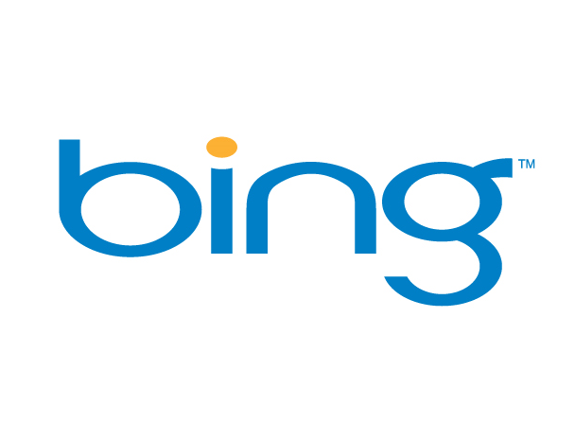
Based in Washington
Parent company—Microsoft
40 languages
Integration with other media companies
Microsoft Failed $42.0 billion Yahoo! bid in 2008
December 2009: Yahoo and Microsoft announce partnership for Bing to provide algorithmic and paid-search platform for Yahoo’s websites worldwide¹
Microsoft Bing ROS= -62.24%
Google ROS = 28.79%
Notes:
Hoopes, Stephen. Search Engines in the US. Rep. no. 51913a. IBISWorld, Aug. 2014. Web. <http://clients1.ibisworld.com.ezproxy.bu.edu/reports/us/industry/default.aspx?entid=1982>.

Slide 5

Feeling lucky?
Based in Mountain View, CA
52,069 employees and $16,823.1 billion in revenue
Founded by Sergey Brin & Larry Page while at Stanford graduate school
Offers:
Google Search
Gmail
Google Earth
Generates income from Google AdWords ¹
ROS= 28.79%
Notes:
Hoopes, Stephen. Search Engines in the US. Rep. no. 51913a. IBISWorld, Aug. 2014. Web. <http://clients1.ibisworld.com.ezproxy.bu.edu/reports/us/industry/default.aspx?entid=1982>.

Slide 6
Search Engine Industry: Favorable
Force | Industry Average | Firm vs. Industry Average
Threat of Entry | Low | Weaker
Supplier Power | Low | Same
Buyer Power | Low | Weaker
Rivalry | Medium | Weaker
Substitutes | Low | Stronger
Overall | π> than economic average | π< than industry average
Notes:
Hoopes, Stephen. Search Engines in the US. Rep. no. 51913a. IBISWorld, Aug. 2014. Web. <http://clients1.ibisworld.com.ezproxy.bu.edu/reports/us/industry/default.aspx?entid=1982>.
2. Russell. "Olsen SM." : Internet and Search Engine Industry. N.p., 7 Sept. 2011. Web. 24 Nov. 2014. <http://olsensm.blogspot.com/2011/09/internet-and-search-engine- industry.html>.
Threat of Entry: Low
Internet providers, social media sites
High entry costs if need to build all infrastructure – harder
Low entry costs when already established internet provider - easier
low differentiation – easier
high awareness (advertising) needed – harder
Overall: Potential entry limits profitability because of the high advertising and awareness costs. Because the industry is easy to enter if already an established internet provider, there are a large number of firms outside of the top three fighting for a small profit.
Power of Suppliers: Low
Internet service providers, internet publishers & broadcasters
search engines don’t own content 
low switching costs
many suppliers 
can outsource development 
ability to backward integrate 
Overall: low
Threat of Substitutes: Low
libraries, encyclopedias, Facebook, other advertising platforms (as this is their form of revenue)
Facebook is just as convenient as any other search engine as long as you have an account 
inconvenient to go to a library 
large size of encyclopedia 
No affect on the firms because substitutes do not affect the convenience or free price of search engines
Overall low threat
Power of Buyers: Low
Advertisers, companies targeting users of search engines
using search is free 
only power is that advertisers pay for additional viewers and clicks 
Large amount of buyers 
Overall: low
Buyer power has no effect on profitability in this industry.
Extent of Rivalry: Medium
Google, Yahoo, Ask.com
constant innovation to provide additional services to users 
constant fight to incentivize use of search engine 
small differences between competitors 
Fewer than 6 major players in the market 
Favorable supply and demand 
Low switching costs for users 
Overall: low
Despite low rivalry, firms are fighting for small profits

Slide 7
Trending Now
Industry Trend #1: Social Media
Consumers are visiting social networking sites more often than search engines
Suppliers are looking to advertise on social media sites, like Facebook
Industry Trend #2: Mobile Search
The desktop computer is on the out and searching from devices on the rise
Search engine more accessible
Impact on 5 Forces
Substitutes
Buyer Power
BTE
Buyer Power
BTE
Rivalry
Impact on Industry Π
Notes:
*Search engine companies are also starting to acquire social media sites because of these trends
Sources:
"Suddenly, Google Looks Shaky." Yahoo Finance. N.p., n.d. Web. 24 Nov. 2014. <http://finance.yahoo.com/news/suddenly-google-looks-shaky-174232846.html>.
Goodsell, Ben. "Fast SEO Competitive Analysis Part 2: Competing Content Comparison." Search Engine Watch. ClickZ, 31 Oct. 2014. Web. 24 Nov. 2014. <http://searchenginewatch.com/article/2378742/Fast-SEO-Competitive-Analysis-Part-2-Competing-Content-Comparison>.
Hoopes, Stephen. Search Engines in the US. Rep. no. 51913a. IBISWorld, Aug. 2014. Web. <http://clients1.ibisworld.com.ezproxy.bu.edu/reports/us/industry/default.aspx?entid=1982>.

Slide 8
Bing is Unfavorable vs. Industry
Potential Entry→ Advantage: Bing and Yahoo partnered to allow advertisers to display ads on both sites with the Yahoo Bing Network
Suppliers → No advantage or disadvantage
Substitutes → advantage: Microsoft has made moves to leverage sites like Facebook and Twitter into their search engine.
Buyers → disadvantage/advantage: Advertisers are seeing higher Click-Through-Rates using Google Adwords but save with Bing and Yahoo with a lower Cost-Per-Click.
Rivalry → disadvantage: Google dominates with 2/3 of searches taking place at Google
Notes:
Sources:
Miners, Zach. "Bing Weaves More Facebook, Twitter Data into Search Results." Computerworld. N.p., 21 Mar. 2013. Web. 24 Nov. 2014. <http://www.computerworld.com/article/2495705/internet/bing-weaves-more-facebook--twitter-data-into-search-results.html>.
Noel, Rick. "Google AdWords Vs Yahoo Bing Network - EBiz ROI, Inc." EBiz ROI, Inc. N.p., 16 May 2015. Web. 24 Nov. 2014. <http://www.ebizroi.com/google-adwords-vs-yahoo-bing-network/>.

Slide 9




Bing: Stuck in the Middle
Cost Leadership
Differentiation
Broad market
Narrow market
Notes:
Bing’s Future
Cost Leadership—attracts marketers
Lower costs than Google
Differentiation—gains users
User Friendly
Partnerships
Facebook
Fandango
Smart search
Assumes users intent
Taking up Yahoo! position
Smartphone advantage in Asia
Nokia is common
Windows connects with Bing
Strategic Activities
Search Engine—gives marketers clues
Continuous innovations
Google Maps
Google Drive
Other
Android
Products
Google’s success
Differentiation
IT Infrastructure
Many users
Valued Investment

Slide 10
Bing’s excessive advertising leads to operating loss
Bing Charges at $1.22 per click
Notes:
Assumption:
We knew that the average price for a click set by the industry is approximately $1.47. We also know that Microsoft’s costs for each section that was found from IBIS world. Since we knew that MSFT has significantly higher advertising costs. We also know that Yahoo has recently been focusing on purchases so the average purchases in the industry must be higher. We also know that the industry has a $.22 margin, while Bing has none since they are operating at a loss.

Slide 11
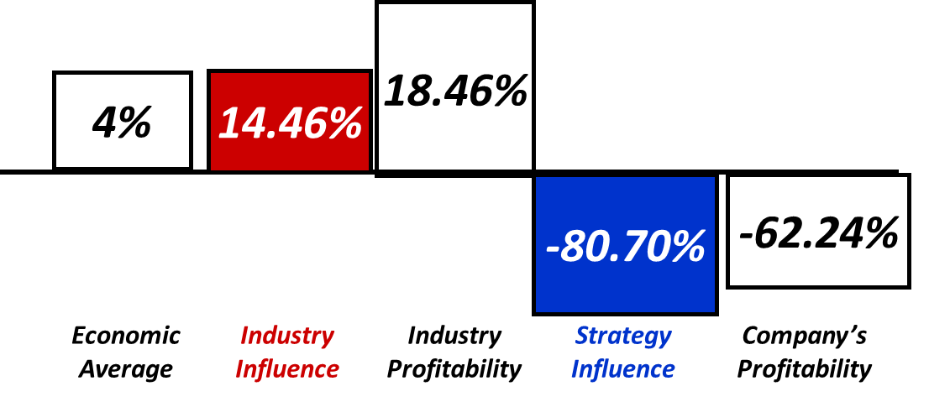
Bing Sinks Industry Average
Firm | Valuable? | Rare? | Costly to imitate? | Capture value?
Google Brand | Yes | Yes | Yes | Yes
Bing Brand | No | -- | -- | --
Notes:
Return on Sales:
Microsoft, Google, and Yahoo are from IBIS World
AOL from MorningStar
-Return on Sales is calculated from revenue and operating income because ISBIS World Provides these numbers specifically for the search engine segments of each company.
ideally would use ROE as it shows how efficient companies use their equity base for the search engines, but we were unable to find equity figures specific to Search engine only
Google—Brand Name
Valuable?
“Google it”
Everyone just uses it without realizing other search engine
Known due to its fastest algorithm.
Rare
No one else has same kind of clout.
It has 72% market share for a reason!
Costly?
Very high investments for competitors to catch up.
Capture Value?
Continue to grow. Acquisitions are at place.
Horizontal scope is increasing (Google Glass)
Everything they do helps their brand name—sustains profitability in long term
Google’s Key Resources
Tangible Resources--$5 billion
Googleplex
Intangible Resources-- +$100 billion
Internet presence
Valuable network
Large, computer savvy workforce
Access to top universities
Bing—Brand Name
Valuable?
No. Bing has extremely low awareness compared to Google
Bing Key Resources
Tangible Assets
Microsoft’s financial power
Intangible Assets
Programmers
“Decision Engine”
Partnerships with social media
Captures more users

Slide 12
The Future of Search Engines
Google
2014 decrease in ads
Poor global economy
Increasing global competition
Bing
Baidu
Naver
Plan to increase speed of data
Increase market share more than 75%
Bing
Taking up Yahoo! position
Lower costs attracts advertisers
Differentiation gains users
Smartphone advantage in Asia
Nokia is common
Windows connects with Bing

Slide 13
“Google is synonymous with search”
Strategic Activities
Search Engine—gives marketers clues
Continuous innovations
Google Maps
Google Drive
Other
Android
Products
Google’s success
Differentiation
IT Infrastructure
Many users
Valued Investment
Notes:
Its strategic activities include its search engine which is where ads are placed and that is their main source of revenue. They have other innovations such as google maps and google drive which are extremely popular with users. They have started software design on android phones where they provide apps—that makes their presence in Asia where Android is more common huge.
IT infrastructure is a huge reason why they are a success. They have high speed data available. They also have more data, which means more users and therefore more ads and more money. Its different in the sense that it started offering better service—better search engine, better activities (Maps, drive, google earth etc) which competitors didn’t have at first).

Slide 14
Google’s Value Chain
Financing, data, ease of use, relevancy of results
Firm Infrastructure
Support Activities
consumer communication, recruiting
Human Resources
Data Coding, Product Innovation, easy to connect
Technology
Data communication, user friendly, well known
Procurement
None for Search Engine Business
Server Operations, Various Products,
Promotions, new businesses, partnership
Customer Feedback, Ongoing advertising
Primary Activities
Inbound, Outbound Logistics
Operations
Marketing and Sales
Service
Notes:
Operations and its marketing have really made it excel.
Its operations have allowed it to succeed, gaining maximum users. That’s what advertisers want, which is why google can charge a premium. It then has higher costs because of quality services– for example they will spend more on its google maps services to get accurate information about current location and tracking with satellite which will cost more.

Slide 15
Key Drivers
Google
Industry
High investment for quality
Searching Speed Costs
Gains users
Advertisers accepts premium
Specialize in certain service
Suitable algorithm
Aggressive Marketing
Traffic acquisition costs
Licensing
Notes:
Fast data is obvious, its convenient. Specialization—Yahoo has an advantage in finance because of its user friendly way.
Its operations have allowed it to succeed, gaining maximum users. That’s what advertisers want, which is why google can charge a premium. It then has higher costs because of quality services– for example they will spend more on its google maps services to get accurate information about current location and tracking with satellite which will cost more.

Slide 16
Battle of the Brands
Firm | Valuable? | Rare? | Costly to imitate? | Capture value?
Google | Yes | Yes | Yes | Yes
Bing | No | -- | -- | --
Notes:
Google—Brand Name
Valuable?
“Google it”
Everyone just uses it without realizing other search engine
Known due to its fastest algorithm.
Rare
No one else has same kind of clout.
It has 72% market share for a reason!
Costly?
Very high investments for competitors to catch up.
Capture Value?
Continue to grow. Acquisitions are at place.
Horizontal scope is increasing (Google Glass)
Everything they do helps their brand name—sustains profitability in long term
Google’s Key Resources
Tangible Resources--$5 billion
Googleplex
Intangible Resources-- +$100 billion
Internet presence
Valuable network
Large, computer savvy workforce
Access to top universities
Bing—Brand Name
Valuable?
No. Bing has extremely low awareness compared to Google
Bing Key Resources
Tangible Assets
Microsoft’s financial power
Intangible Assets
Programmers
“Decision Engine”
Partnerships with social media
Captures more users

Slide 17
Google Benefits from Company’s Horizontal Scope
Bing Product | Google Equivalent | Better Off Test (W ↑ or C ↓ ?) | Form of Agreement | Ownership Test
Bing.com | Google.com |  | Ownership
Bing Desktop |  | Encourages people to use Bing search engine. W ↑ | Ownership | If this was not owned by Microsoft, then the technology would simply use whichever search engine is more popular in demand.
Maps | Maps
OneDrive | Google Drive
Images | Images
OneDrive | Drive
Outlook | Gmail
News | News
 | Glass | These devices are supported by Google’s search engine. Drives more traffic to the site due to brand awareness. Google is also able to collect better data through these devices, and thus place more relevant ads for paying customers. W ↑ | Ownership | Owning these product lines help Google achieve the innovative image, and relate directly to users.
 | Watch |  | Ownership
 | Smartphone |  | Ownership
 | Chromebook |  | Ownership
Horizontal scope is even at industry level
Complementary assets give Google a competitive advantage
Notes:
As far as the search engine division goes, both players have a similar horizontal scope. However, the horizontal scope of the parent companies, Google is more, and effectively, diversified than Microsoft. For instance, their leadership in wearable technology allows them to collect lots of data to make relevant ads. In addition, the brand value (which affects user choices) is easily created for Google.com due to Google’s physical products. For Bing.com, it is less apparent as Microsoft does not innovate as much (less chance of data collection) and Microsoft uses different names for their products/ services.

Slide 18
Bing’s Vertical Scope: Insufficient
Bing Product | Google Equivalent | Better Off Test (W ↑ or C ↓ ?) | Form of Agreement | Ownership Test
Bing.com | Google.com |  | Ownership
Bing Ads API | Google Analytics |  | Ownership
Bing Ads | AdWords |  | Ownership
 | AdSense | Improves ad relevance when targeting users. W ↑ | Ownership | Gives advertising with Google competitive advantage
Yahoo! Search |  | These two website use Bing.com to power their searches. Thus, it should increase volume for Bing.com given that these websites have sufficient visitors. W ↑ | Strategic Alliance
msn.com |  |  | Ownership | Allows putting all Microsoft’s services, including Bing, on one page, like a one stop shop (Pic below) without contracts/ fees in place
 | Google Chrome | Increases traffic for the search engine. W ↑ | Ownership | All data collected goes to Google. Taskbar used as search bar.
Google Chrome is the key difference in vertical scope
Notes:
Google has a better vertical scope than Microsoft due to its AdSense service. It allows Google to host and place targeted ads on third party websites. Although Microsoft does have more distribution (as they power searches on Yahoo! and msn.com), not enough volume is driven to those sites for Bing to benefit greatly from. Also, browsers often times determine the search engine that people initially use. In this case, Google.com is supported well by Google Chrome. Bing.com, on the other hand, is the default for Microsoft’s Internet Explorer, which is less popular and user friendly than Chrome or Safari.

Slide 19
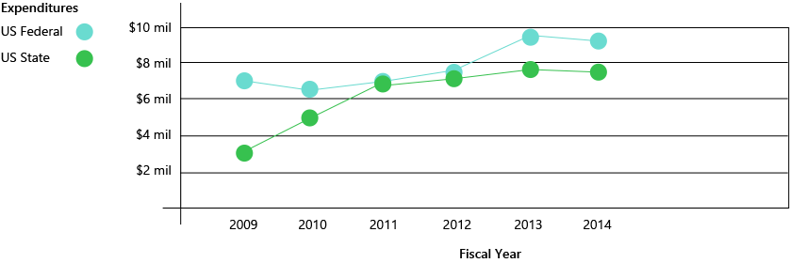
Microsoft gives the user the power to disclose privacy
ISSUE: data collection disrupts personal privacy
Internet Explorer’s “Do Not Track”
By default
No Outlook or Email scanning for advertising
Take advantage of European Commissions plan to break up Google
Entire Company’s non-market strategy
Expenses primarily consist of lobbying and consulting fees
Notes:
Winkler, Rolfe, Tom Fairless, and Harriet Torry. "Pressing A Google Breakup." Wall Street Journal [New York City] 22 Nov. 2014, Corporate News sec.: B3. Print.
Idea is to not track and give privacy to the user. People don’t want their data to necessary be collected so this is a way.
Microsoft Should take advantage of the EC’s plan, backed by Germany, to disintegrate Google. Google holds 90% market share in the search engine industry in Europe which is unhealthy competition. Its pretty much a monopoly. Microsoft Bing should take advantage of this opportunity in order to break into an region that has huge economic potential, despite its current market volatility. In fact, they should even lobby and push the EC to disintegrate Google in order to gain more influence in the search engine industry. If this passes, the next step would be to push the same in the United States.

Slide 20

Corporate Social Responsibility
Stakeholders:
Non-profit organizations, educators, Microsoft employees
Freeman’s CSR – focus on how the company can help the community, in turn helps the shareholders.
Notes:
Microsoft Citizenship Report 2014
Free microsoft office 365 for all students and teachers
Skype in the classroom
- connect classrooms across the globe
Computer Science Education – Technology Education and Learning in Schools
- teach kids about computer science
- places Microsoft Employee volunteers in high school classrooms across the US
- teach coding and programming
Imagine Cup
- competition for youth to develop technical solutions
DreamSpark
- free access to Microsoft designer and developer tools for high schools
BizSpark
- software given to startups
- connection to investors and key industry players
YouthSpark on GlobalGiving
- fundraising platform that gives individuals a direct and easy way to support young people in their quest for training, education, job placement, and entrepreneurship opportunities.

Slide 21
Apps may disrupt use of Web Search
Role of Innovation:
Improved search and ad placement algorithms over time
Industry Throwback:
Most recent disruptive technology: In 1993, JumpStation started using the Web to search rather than prior engines powered on the Internet.
Key sustaining innovations:
Yahoo made first modern search engine
Google listed pages according to all terms on the web page being able to be tagged, and they listed pages in terms of popularity rather than order of being searched
Voice search will be an increasingly important technology as people start using wearable tech, although it is not a disruptive technology
Threat of Disruption:
Users seem to change to applications for information rather than web search

Slide 22
Overcoming Industry Level Issues
Key Challenges:
Advertisers are using social media as a platform, rather than search engines
Users are turning to apps rather than web search for their information
Industry’s Attempts & Solutions:
Current actions:
Introduced social media under company (Google+ & Socl)
Bing partners with Twitter and Facebook to have integrated
Google introduces own apps to meet users’ needs
Bing should:
Develop apps using Bing’s services
Create a search engine for apps

Slide 23
Browse Bing and Get Global!
Bing Browser
Solves brand name issue
Streamlines and encourages use of the search engine
Increases vertical scope
Add more languages to Bing search offerings
Become go-to search in foreign countries
Ties into CSR in tying global classrooms together
Take advantage of EC’s plan to disintegrate Google
Notes:
Users are more likely to use the search engine of the browser, so Bing should have a user friendly browser to drive traffic to their search engine.

Slide 24
Create the Bing Generation
The phrase “Google it” is one that our generation grew up with
Even when team members consciously tried to switch over to Bing during the span of this project, their fingers were too used to typing google.com when first opening a browser
Solution:
Make the next generation a Bing Generation
Leverage CSR in Schools
Custom search for children

Slide 25
Increase Horizontal & Vertical Scope under Bing
Develop consumer products using Bing brand name
Create an innovative image for Bing which could drive people to use their online products
Products can be made to work best with Bing.
Bing Browser
Solves brand name issue
Streamlines and encourages use of the search engine
Increases vertical scope
Add more languages to Bing search offerings

Slide 26
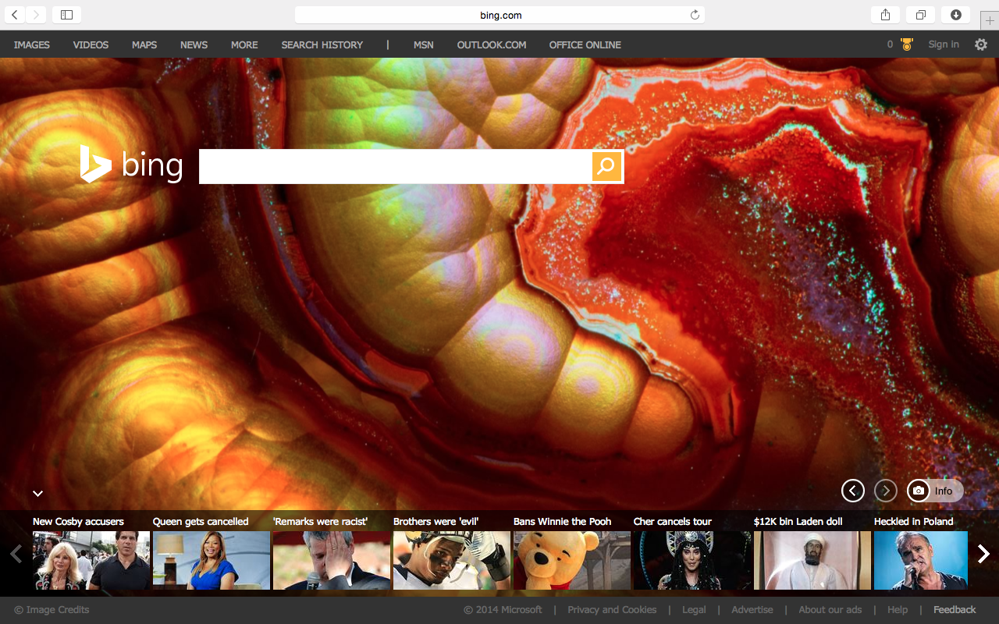

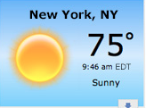
My Homepage
Absorb MSN features to build customizable homepage
Phase out msn.com
Merge users on to new Bing webpage
Showcase:
News selections
Weather
Recent searches
Newsfeed-like
Purpose:
Drive more traffic to Bing.com

Slide 27
bibliography
Admin, Techie. "Learn How Google Search Works? From Algorithms to Answers in Animations." Welcome to Support IT Desk RSS. N.p., n.d. Web. 24 Nov. 2014. <http://www.supportitdesk.com/learn-how-google-search-works-from-algorithms-to-answers-in-animations/>.
Barr, Alistair, and Rolfe Winkler. "At Google, Heavy Spending Takes Toll." Wall Street Journal [New York City] 17 Oct. 2014, Market Place sec.: B1+. Print.
Goodsell, Ben. "Fast SEO Competitive Analysis Part 2: Competing Content Comparison." Search Engine Watch. ClickZ, 31 Oct. 2014. Web. 24 Nov. 2014. <http://searchenginewatch.com/article/2378742/Fast-SEO-Competitive-Analysis-Part-2-Competing-Content-Comparison>.
Hoopes, Stephen. Search Engines in the US. Rep. no. 51913a. IBISWorld, Aug. 2014. Web. <http://clients1.ibisworld.com.ezproxy.bu.edu/reports/us/industry/default.aspx?entid=1982>.
"The Industry Handbook: The Internet Industry | Investopedia." Investopedia. N.p., n.d. Web. 24 Nov. 2014. <http://www.investopedia.com/features/industryhandbook/internet.asp>.http://olsensm.blogspot.com/2011/09/internet-and-search-engine-industry.html
"Internet Information Providers Overview: Industry Center - Yahoo Finance." Internet Information Providers Overview: Industry Center - Yahoo Finance. Yahoo!, n.d. Web. 24 Nov. 2014.
MacMillan, Douglas, Brian R. Fitzgerald, and David Benoit. "Yahoo Gets Boost From Mobile Ads." Wall Street Journal [New York City] 22 Oct. 2014, Corporate News sec.: B3. Print.
MacMillan, Douglas, and David Benoit. "Yahoo CEO Set to Refresh Turnaround Plan." Wall Street Journal [New York City] 20 Oct. 2014, Technology sec.: B6. Print.
Miners, Zach. "Bing Weaves More Facebook, Twitter Data into Search Results." Computerworld. N.p., 21 Mar. 2013. Web. 24 Nov. 2014. <http://www.computerworld.com/article/2495705/internet/bing-weaves-more-facebook--twitter-data-into-search-results.html>.
Noel, Rick. "Google AdWords Vs Yahoo Bing Network - EBiz ROI, Inc." EBiz ROI, Inc. N.p., 16 May 2015. Web. 24 Nov. 2014. <http://www.ebizroi.com/google-adwords-vs-yahoo-bing-network/>.
Russell. "Olsen SM." : Internet and Search Engine Industry. N.p., 7 Sept. 2011. Web. 24 Nov. 2014. <http://olsensm.blogspot.com/2011/09/internet-and-search-engine-industry.html>.
"SEO: The Free Beginner's Guide from Moz." Moz. N.p., n.d. Web. 23 Nov. 2014. <http://moz.com/beginners-guide-to-seo/how-search-engines-operate>.
"Suddenly, Google Looks Shaky." Yahoo Finance. N.p., n.d. Web. 24 Nov. 2014. <http://finance.yahoo.com/news/suddenly-google-looks-shaky-174232846.html>.
Winkler, Rolfe, Tom Fairless, and Harriet Torry. "Pressing A Google Breakup." Wall Street Journal [New York City] 22 Nov. 2014, Corporate News sec.: B3. Print.

